Slide 1
Introduction to
Neural Networks

Slide 2
Agenda
Introduction to the Brain
Introduction to Neural Networks
Gradient Descent
Resources for Further Study

Slide 3
Agenda
Introduction to the Brain
Introduction to Neural Networks
Gradient Descent
Resources for Further Study

Slide 4
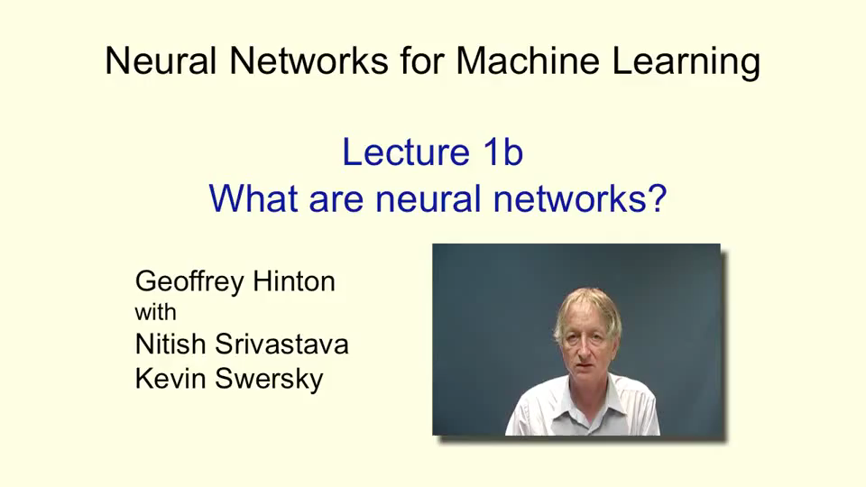
Inspiration
Geoffrey Hinton, a pioneer in the resurgence of interest in Neural Networks shares an overview of the brain.
Source: https://class.coursera.org/neuralnets-2012-001/lecture/7

Slide 5
Agenda
Introduction to the Brain
Introduction to Neural Networks
Gradient Descent
Resources for Further Study

Slide 6
Perceptron
Initially, in the 1960s, artificial neurons were modeled using something called a perceptron, which is a step function
Notes:
Exercise: Let’s say that your problem is predicting whether someone will default on their credit card and you know they are a male, student, with an annual income of 50000. weights are 0.5, 0.2, and .050 with a bias of -100. Would this person default?

Slide 7
Perceptron
Initially, in the 1960s, artificial neurons were modeled using something called a perceptron, which is a step function
Notes:
Exercise: Let’s say that your problem is predicting whether someone will default on their credit card and you know they are a male, student, with an annual income of 50000. weights are 0.5, 0.2, and .050 with a bias of -100. Would this person default?

Slide 8
Perceptron
Initially, in the 1960s, artificial neurons were modeled using something called a perceptron, which is a step function
Notes:
Exercise: Let’s say that your problem is predicting whether someone will default on their credit card and you know they are a male, student, with an annual income of 50000. weights are 0.5, 0.2, and .050 with a bias of -100. Would this person default?

Slide 9
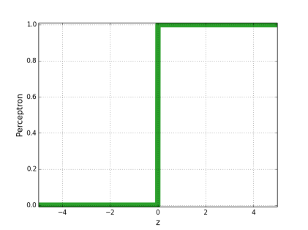
Perceptron
Initially, in the 1960s, artificial neurons were modeled using something called a perceptron, which is a step function
Notes:
Exercise: Let’s say that your problem is predicting whether someone will default on their credit card and you know they are a male, student, with an annual income of 50000. weights are 0.5, 0.2, and .050 with a bias of -100. Would this person default?

Slide 10
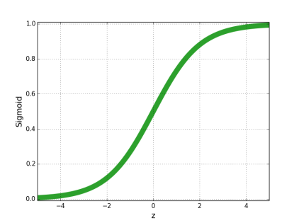
Sigmoid Function
In the 1980s, researchers realized they could get better results from a smooth activation function, such as the sigmoid function.
Notes:
Edit these charts

Slide 11
Representation
Artificial neural networks are represented as a system of interconnected neurons with multiple layers.
Notes:
Edit these charts

Slide 12
Input Layer
Input neurons represent the features of the dataset.
Input
Neurons
Notes:
Edit these charts

Slide 13
Output Layer
For supervised learning, the output neuron represents the response variable(s).
Input
Neurons
Output
Neurons
Notes:
In this example there is only one output neuron, however in many cases there will be multiple output neurons. For example, in the case of handwritten digits, you are trying to predict one of 10 classes, each of which is usually represented by it’s own output neuron.

Slide 14
Hidden Layers
Hidden layer are what allow the network to fit highly non-linear patterns.
Input
Neurons
Hidden
Neurons
Output
Neurons
Notes:
Edit these charts

Slide 15
Representation
For feedforward neural networks, the value for each neuron depends only on the neuron values in the previous layer.
Input
Neurons
Hidden
Neurons
Output
Neurons
Notes:
There are also something called reinforcement neural networks. Reinforcement neural networks are interesting because they have feedback loops built in. However, these networks are very difficult to train. This is currently an area of research, how to efficiently train reinforcement neural networks.

Slide 16
Representation
The value for each neuron influences the neuron values in the subsequent layer.
Input
Neurons
Hidden
Neurons
Output
Neurons
Notes:
Edit these charts

Slide 17
Weights
Connections between nodes are defined by a weight value which determines the influence of one neuron on another.
Notes:
Edit these charts

Slide 18
Weights
These weights are learned through an iterative procedure whereby the change in output is repeatedly calculated for gradual changes in the weights.
Notes:
The idea is that we want to find the y-value that gives us the best results by repeatedly updating the weights. How do we update the weights?

Slide 19
Agenda
Introduction to the Brain
Introduction to Neural Networks
Gradient Descent
Resources for Further Study

Slide 20
Gradient Descent - Intuition
Weights are updating according to an algorithm called the gradient descent, an iterative procedure for finding the optimal parameters for a given model.
Notes:
Gradient descent is not unique to Neural Networks, in fact it can be used to find the minimum values for many of the algorithms we have discussed in class although this is not always the preferred method. The idea is that we want to find the y-value that gives us the best results by repeatedly updating the weights. How do we update the weights? The “cost” here is just the mean squared error. || || notation just means the magnitude of the difference.

Slide 21
Gradient Descent - Intuition
Weights are updating according to an algorithm called the gradient descent, an iterative procedure for finding the optimal parameters for a given model.
Notes:
Gradient descent is not unique to Neural Networks, in fact it can be used to find the minimum values for many of the algorithms we have discussed in class although this is not always the preferred method. The idea is that we want to find the y-value that gives us the best results by repeatedly updating the weights. How do we update the weights? The “cost” here is just the mean squared error. || || notation just means the magnitude of the difference.

Slide 22
Gradient Descent - Intuition
Weights are updating according to an algorithm called the gradient descent, an iterative procedure for finding the optimal parameters for a given model.
Notes:
Gradient descent is not unique to Neural Networks, in fact it can be used to find the minimum values for many of the algorithms we have discussed in class although this is not always the preferred method. The idea is that we want to find the y-value that gives us the best results by repeatedly updating the weights. How do we update the weights? The “cost” here is just the mean squared error. || || notation just means the magnitude of the difference.

Slide 23
Gradient Descent - Intuition
Weights are updating according to an algorithm called the gradient descent, an iterative procedure for finding the optimal parameters for a given model.
Notes:
Gradient descent is not unique to Neural Networks, in fact it can be used to find the minimum values for many of the algorithms we have discussed in class although this is not always the preferred method. The idea is that we want to find the y-value that gives us the best results by repeatedly updating the weights. How do we update the weights? The “cost” here is just the mean squared error. || || notation just means the magnitude of the difference.

Slide 24
Gradient Descent - Intuition
Weights are updating according to an algorithm called the gradient descent, an iterative procedure for finding the optimal parameters for a given model.
Notes:
Gradient descent is not unique to Neural Networks, in fact it can be used to find the minimum values for many of the algorithms we have discussed in class although this is not always the preferred method. The idea is that we want to find the y-value that gives us the best results by repeatedly updating the weights. How do we update the weights? The “cost” here is just the mean squared error. || || notation just means the magnitude of the difference.

Slide 25
Meta-Evaluation

Slide 26
Meta-Evaluation
Advantages:
Neural networks give amazing flexibility to fit complex and non-linear functions
For this reason, Neural networks can produce impressive predictive results that exceed any of the algorithms we have previously learned

Slide 27
Meta-Evaluation
Advantages:
Neural networks give amazing flexibility to fit complex and non-linear functions
For this reason, Neural networks can produce impressive predictive results that exceed any of the algorithms we have previously learned
Disadvantages:
Neural networks can be computationally expensive, requiring a lot of time / processing power
Neural networks function as a “black box” with low interpretive value

Slide 28
Agenda
Introduction to the Brain
Introduction to Neural Networks
Gradient Descent
Resources for Further Study

Slide 29
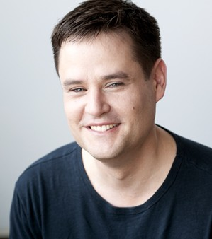
Resources
Michael Neilson has a free book called Neural Networks and Deep Learning
Ch. 1: Using Neural Networks to recognize handwritten digits
Ch. 2: How the backpropagation algorithm works
Ch. 3: Improving the way the neural networks learn
Ch. 4: A visual proof that Neural Networks can compute any function

Slide 30

Resources
Geoffrey Hinton, one of the pioneers of the deep learning movement, has an entire class on Coursera called Neural Networks for Machine Learning
Some of the topics that we didn’t cover
Neural Networks with Feedback Loops – Recursive Neural Networks
Ensembling Neural Networks – Bayesian Model Averaging
Unsupervised Neural Networks – Restricted Boltzman Machines (RBM)

